Slide 1


Employee Attrition
Mini Project 1
By Isabelle Uslu

Slide 2
Data Pipeline
Data
Acquisition
Identifying Questions
Data Exploration
Hypothesis Testing
Presentation

Slide 3
Problem Statement
Organizational growth largely depends on staff retention. Losing employees frequently impacts the morale of the organization and hiring new employees is more expensive than retaining existing ones.

Slide 4
Data
Data Source : Kaggle
Original Data (19103 entries)
MMM- YY
Employee ID
Age
Gender
City
Education Level
Salary
Date of Joining
Last Working Date
Joining Designation
Designation
Total Business Value
Quarterly Rating
Additional Columns
Quit Status
Binned Business Value
Binned Age

Slide 5
Data
Quit Status | Percentage
Yes | 0.678706 = 68%
No | 0.321294 = 32%
Data was collected between 01.01.2016 & 01.12.2017

Slide 6
Questions
Does age have an effect on salary among the employees ?
Is there a relationship between quit rate and age groups?
Is there a relationship between quit rate and business value of employees?
Is there a relationship between quit rate and gender of employees?
Is there a relationship between quit rate and educational level of employees?

Slide 7
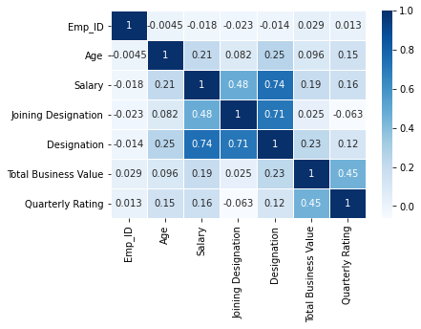
Correlation

Slide 8
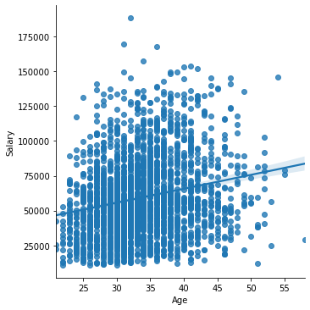
Age vs Salary

Slide 9
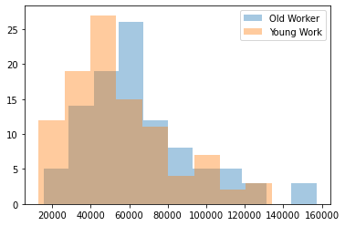
Age vs Salary
Age grouped into 2 by mean (33 yo): -Young worker : Workers below 33 yo - Old worker : Workers above 33 yo

Slide 10
Age vs Salary
Hypothesis Test (The effect of age on salary):
H0: There is no difference between distribution of `Old Worker` & `Young Worker`
H1: There is difference between distribution of `Old Worker` & `Young Worker`
Test Result:
Significance level (Alpha) : 0.05
P value : 0.008
Conclusion : We reject the null hypothesis.

Slide 11
Quit Status vs Age
Age Group | Quit / Yes | Quit / No
Young < 33 | 1369 | 622
Old > 33 | 247 | 143

Slide 12
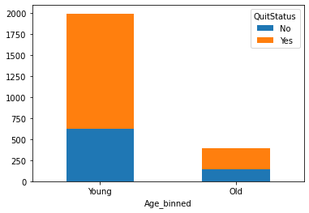
Quit Status vs Age

Slide 13
Quit Status vs Age
Hypothesis Test (Is there a relationship between quit rate and age groups?):
Chi square test
H0: There is no relationship between ‘Age groups’ and ‘Quitting’
H1: There is a relationship between ‘Age groups’ and ‘Quitting’
Test Result:
Significance level (Alpha) : 0.05
P value : 0.041
Conclusion : We reject the null hypothesis

Slide 14
Quit Status vs Business Value
Binned Business Value | Quit / Yes | Quit / No
Low | 1616 | 760
Medium | 0 | 3
High | 0 | 2

Slide 15
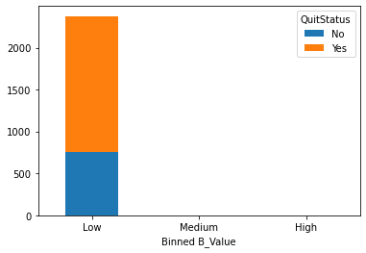
Quit Status vs Business Value

Slide 16
Quit Status vs Business Value
Hypothesis Test (Is there a relationship between quit rate and gender of employees?):
Chi square test
H0: There is no relationship between ‘Business Value’ and ‘Quitting’
H1: There is a relationship between ‘Business Value’ and ‘Quitting’
Test Result:
Significance level (Alpha) : 0.05
P value : 0.005
Conclusion : We reject the null hypothesis

Slide 17
Quit Status vs Gender
Gender | Quit / Yes | Quit / No
Female | 668 | 309
Male | 948 | 456

Slide 18
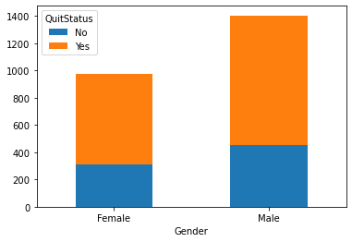
Quit Status vs Gender

Slide 19
Quit Status vs Gender
Hypothesis Test (Is there a relationship between quit rate and gender of employees?):
Chi square test
H0: There is no relationship between ‘Gender’ and ‘Quitting’
H1: There is a relationship between ‘Gender’ and ‘Quitting
Test Result:
Significance level (Alpha) : 0.05
P value : 0.694
Conclusion : We fail to reject the null hypothesis

Slide 20
Quit Status vs Education Level
Education Level | Quit / Yes | Quit / No
Bachelor | 527 | 268
College | 542 | 242
Master | 547 | 255

Slide 21
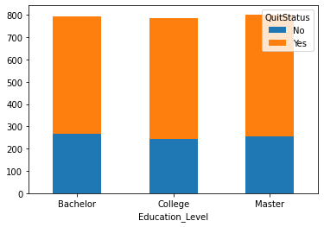
Quit Status vs Education Level

Slide 22
Quit Status vs Education Level
Hypothesis Test (Is there a relationship between quit rate and educational level of employees?):
Chi square test
H0: There is no relationship between ‘Education Level’ and ‘Quitting’
H1: There is a relationship between ‘Education Level’ and ‘Quitting’
Test Result:
Significance level (Alpha) : 0.05
P value : 0.466
Conclusion : We fail to reject the null hypothesis

Slide 23
Answers / Conclusion
1. Does age have an effect on salary among the employees ?
There is difference between distribution of `Old Worker` & `Young Worker`
2. Is there a relationship between quit rate and age groups?
There is a relationship between ‘Age groups’ and ‘Quitting’
3. Is there a relationship between quit rate and business value of employees?
There is a relationship between ‘Business Value’ and ‘Quitting’

Slide 24
Answers / Conclusion
4. Is there a relationship between quit rate and gender of employees?
There is no relationship between ‘Gender’ and ‘Quitting’
5. Is there a relationship between quit rate and educational level of employees?
There is no relationship between ‘Education Level’ and ‘Quitting’

Slide 25
End of Presentation
Any questions?

